Slide 1
Succession to the British throne

Slide 2
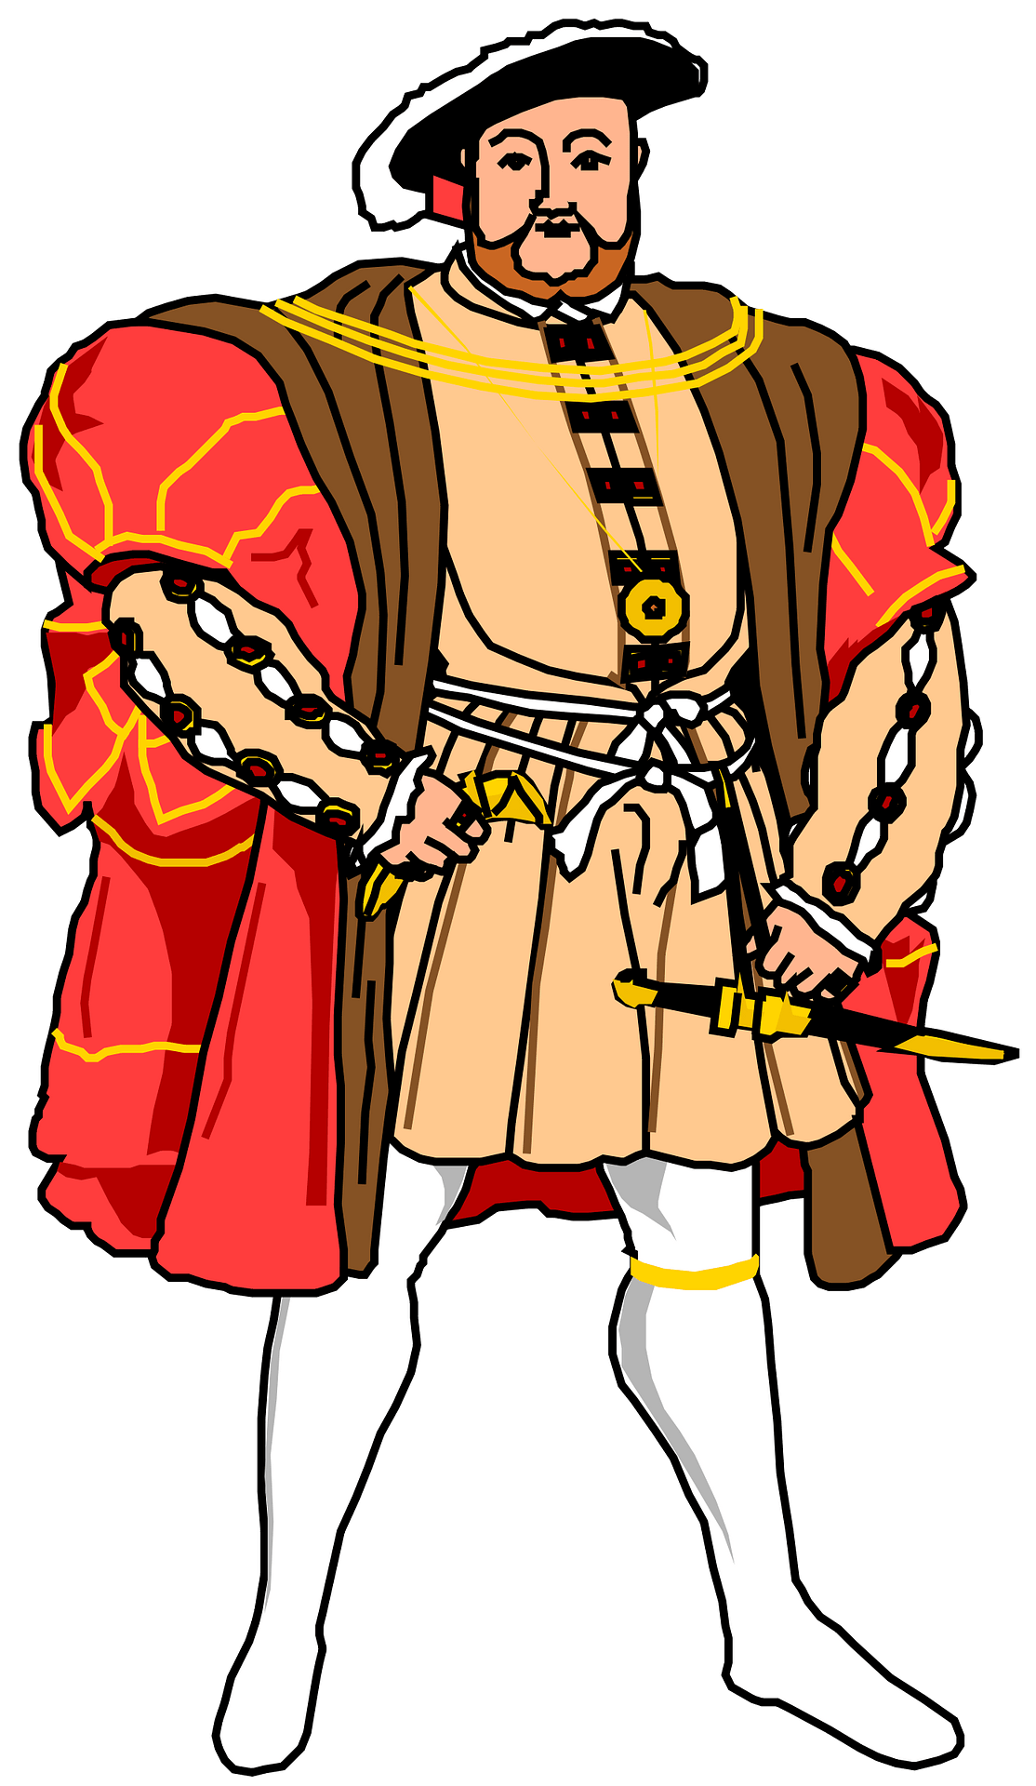
Exercise 7. Succesion to the British throne
Hypotheses:
H1: If x is the king and y is his oldest son, then y can become the king.
H2: If x is the king and y defeats x,
then y will become the king.
H3: Richard III is the king.
H4: Henry VII defeated Richard III.
H5: Henry VIII is Henry VII’s oldest son.
Conclusion:
C: Can become the king?
Check whether the conclusion is a
logical consequence of the set of hypotheses {H1,H2,H3,H4,H5} using the semantic
tableaux method.

Slide 3
-- Theoretical Part --
The Semantic Tableaux Method’s aim is to decide consistency and to find all the models of a formula by decomposing the formula in subformulas. The validity of a formula is proved by contradiction which is what makes it a refutation method (based on the “reductio ad absurdum” principle). For applying this method, we need to use decomposition laws.

Slide 4
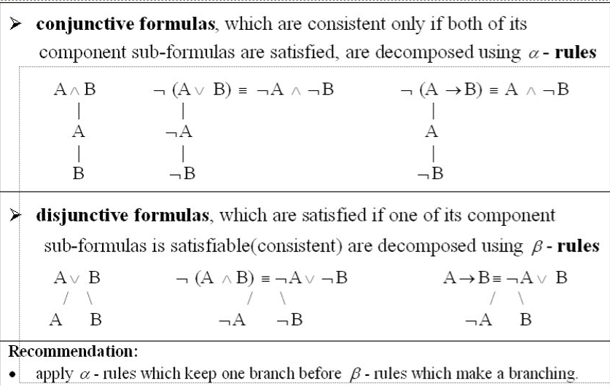
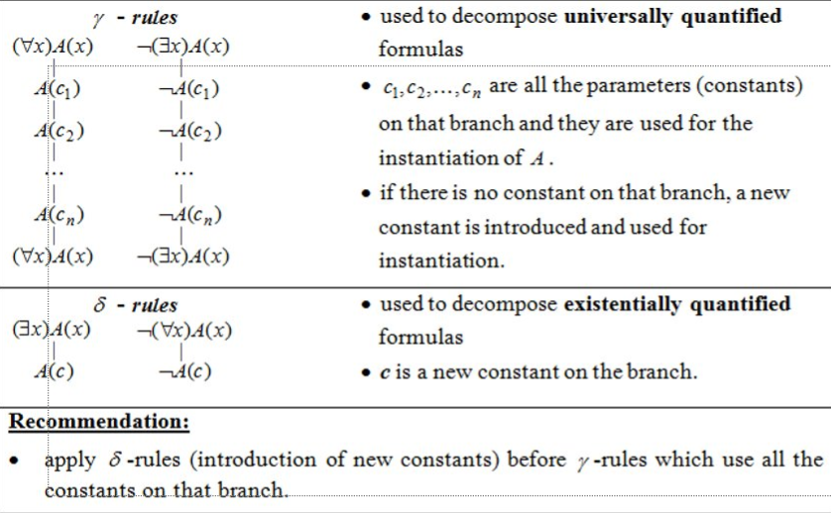

Slide 5
Solution
We transformed the hypotheses and conclusion into formulas using:
variables: x,y
constants: Richard III, Henry VII, Henry VIII
domain: P (all people’s domain)
!! newly defined predicate symbols !!

Slide 6
unary: king : P -> {T,F}
binary: oldestson,defeats : P x P -> {T,F}
king(x)=T if x is king
oldestson(x,y)=T if x is y’s oldest son
defeats(x,y)=T if x defeats y

Slide 7
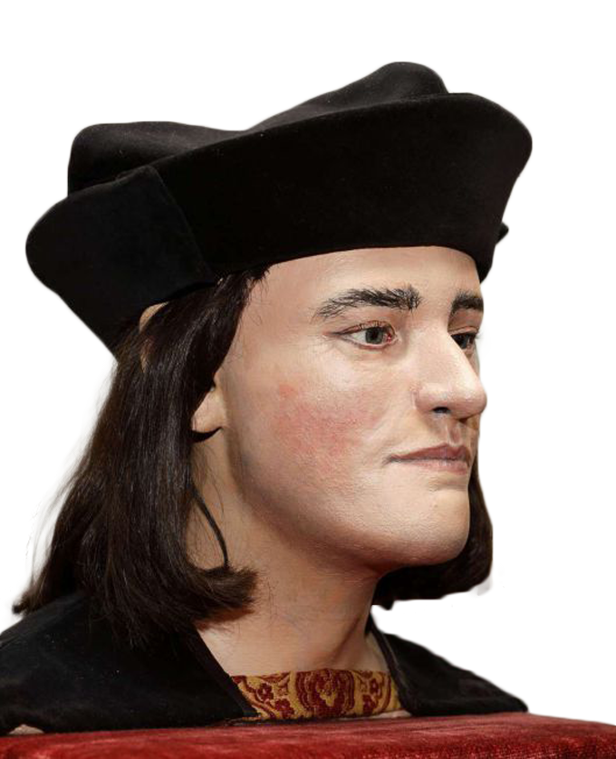
The hypotheses & conclusion become:
H1: (∀x)(∀y)( king(x)∧oldestson(y,x) -> king(y))
H2: (∀x)(∀y)( king(x)∧defeats(y,x) -> king(y))
H3: king(RichardIII)
H4: defeats(HenryVII,RichardIII)
H5: oldestson(HenryVIII,HenryVII)
C: king(HenryVIII)
!! initial hypotheses & conclusion

Slide 8
-- semantic tableau time --
We have obtained a complete and closed tableau with no open branches and 5 closed branches containing the following pairs of opposite literals: [king(HenryVIII),¬king(HenryVIII)],
[king(HenryVII),¬king(HenryVII)], [oldestson(HenryVIII,HenryVII),¬oldestson(HenryVIII,HenryVII)],
[king(RichardIII),¬king(RichardIII)],
[defeats(HenryVII,RichardIII),¬defeats(HenryVII,RichardIII)]

Slide 9

Conclusion
Using the semantic tableaux method, with the appropriate rules, we proved that the conclusion C is derivable from the set of hypotheses {H1,H2,H3,H4,H5} and Henry VIII can, become the king.

